Slide 1
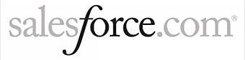
Supersized Data?
Get Real-time Insights
Stephen Sorkin
VP, Engineering, Splunk
Narayan Bharadwaj
Director, Monitoring, Salesforce.com

Slide 2


About Us
Public Enterprise Cloud Computing Company
87,200 customers and growing
Real-time, multi-tenant architecture revolutionizes how companies collaborate and communicate with their customers
Founded 2004, $66M revenue in 2010, 96% y-o-y growth
2,300 customers in 74 countries, including 50 of the Fortune 100
Major use cases: Application Management, Operations Management, Developers, Security, Business and Web Analytics
Notes:
Our third case study today is Salesforce.
They have 87000 customers now!
There are over 300 Splunk users at Salesforce, running a combined total of around 100K Splunk searches every month.
They primarility use Splunk to
Chart queue times per customer.
Figure out which users and organizations are using a particular feature.
And monitor performance for their customers

Slide 3
What We’ll Talk About
Splunk and the Big Data Challenge
Real life examples of Splunk solving data challenges
Salesforce.com’s usage of Splunk

Slide 4

Machine Generated Data Exhaust
“Human-generated data can grow only as fast as human data-generating activities allow it to…
but machine-generated data is limited only by capital budgets and Moore’s Law. So machines’ ability to generate data is growing a lot faster than humans’.”
-Curt Monash, Industry Analyst

Slide 5
Observations
Massive datasets are almost always time stamped, heterogeneous, and difficult to fit into traditional SQL database
  Multiple sources, Unstructured data
Time is the best correlator for heterogeneous data sources
  Timestamps for interpreting events that happened around the same time
  Real-time increasingly required
  Need both recent and historical information
Notes:
Machine-generated IT data is another category of data. It’s non-standard, time-series based and high volume. It’s also variable and dynamic.
IT data is generated by almost every component in IT – formats and sources vary widely. Timestamps are really the only thing you can use to correlate these data sources
…Time sensitive data store (faster retrieval for recent events)

Slide 6
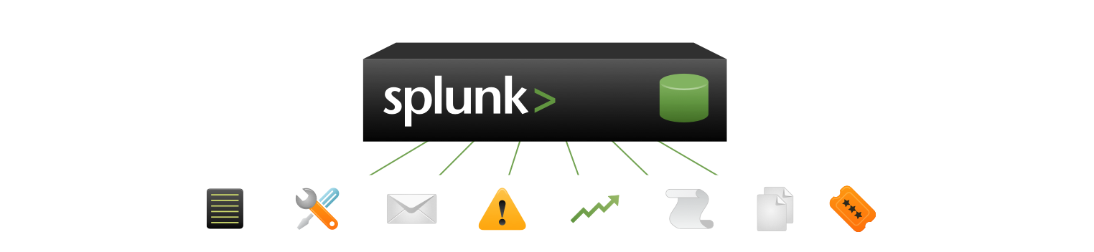
Splunk: The IT Data Engine
No predefined schema, no custom connectors, no RDBMS, no need to filter/forward.
Customer
Facing Data
Outside the Datacenter
Click-stream data
Shopping cart data
Online transaction data
Manufacturing, logistics…
CDRs & IPDRs
Power consumption
RFID data
GPS data
Logfiles
Configs
Messages
Traps
Alerts
Metrics
Scripts
Changes
Tickets
Windows
Linux/Unix
Virtualization
& Cloud
Applications
Databases
Networking
Registry
Event logs
File system
sysinternals
Configurations
syslog
File system
ps, iostat, top
Hypervisor
Guest OS, Apps
Cloud
Web logs
Log4J, JMS, JMX
.NET events
Code and scripts
Configurations
Audit/query logs
Tables
Schemas
Configurations
syslog
SNMP
netflow
Notes:
Splunk is a data engine for your IT data. It gives you real-time visibility and intelligence into what’s happening across your IT infrastructure – whether it’s physical, virtual or in the cloud.
Everybody now recognizes the value of this data, the problem upto now has been getting to it.
At Splunk we applied the search engine paradigm to being able to rapidly harness any and all of the IT data. The “no predefined schema” design, means you can point Splunk at any of your data, regardless of format, source or location. There is no need to build custom parsers or connectors, there’s no traditional RDBMS, there’s no need to filter and forward.
Here we see just a sample of the kinds of data Splunk can ‘eat’.
Reminder – what’s the ‘big deal’ about machine-generated IT data? It holds a categorical record of the following:
User transactions
Customer behavior
Machine behavior
Security threats
Fraudulent activity
You can imagine that a single user transaction can span many systems and sources of this data, or a single service relies on many underlying systems. Splunk gives you one place to search, report on, analyze and visualize all this data.

Slide 7



New Approach to Heterogeneous Data
Universal Indexing
Search-time Knowledge
Flexibility and
Fast Time to Value
No data normalization
Automatically handles timestamps
Parsers not required
Index every term & pattern “blindly”
No attempt to “understand up front
Knowledge applied at search-time
No brittle schema to work around
Multiple views into the same data
Splunk helps find transactions, patterns and trends
Normalization as it’s needed
Faster implementation
Easy search language
Multiple views into the same data
Notes:
Data normalization – it’s hard to let go of. For decades we’ve been taking information and chopping it into rows and columns, and then looking up the data by referencing those like a virtual address. Unfortunately, with the radical increase in machine-generated data around most organizations, there aren’t enough skilled people to define how that data should be handled. Like how search overtook directories in how we navigate the Internet, search is the only way to handle so much data, in so many formats, and subject to change without notice.
Universal indexing is a way of handling text based, time series data. Those are the only limitations for Splunk – the data must be text based (or converted into text) and must be orderable into a series. From there, Splunk handles the rest. It finds most timestamps (or creates one), breaks up the raw data stream into discrete events and retains the original data in a compressed form on disk. No normalization, no modification, just a flat-file index on top of the original, now compressed, data.
Search is the where the data is customized for how you want to visualize your IT information. At search time, fields are extracted that can be used like database ‘columns’ to pivot data. If you don’t like the fields Splunk finds, define your own with the graphical field extractor. Then you can create relationships between the rows, using event types to name certain kinds of events for easy aggregation and searching, or define transactions that tie events from multiple systems together into a logical structure. With that limited and easy to create structure, you can find almost any data or pattern across petabytes of information directly from the web UI, without mastering SQL or statistical query languages. Best of all, it’s data your way. Don’t like your search, or your schema? Just re-write or delete it – the data is unchanged. Any user can pivot their lens onto the underlying data without affecting others – unless, of course, they choose to share their knowledge through apps and shared searches.

Slide 8
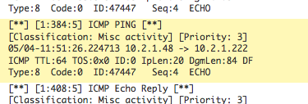
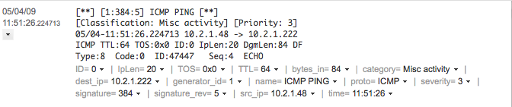
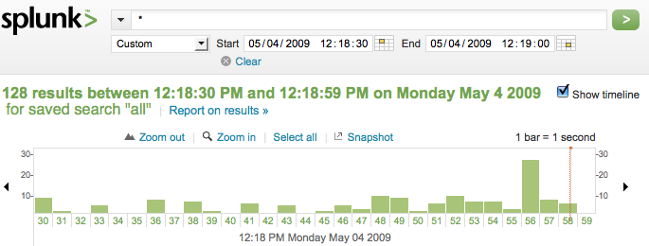
Inside Universal Indexing
Automatic event boundary identification
Automatic timestamp normalization
...enable accurate searching and
trending by time across all data:

Slide 9
Inside Search-time Knowledge Extraction
Automatically
discovered fields
And user-defined fields
... enable statistics and precise search on specific fields:

Slide 10
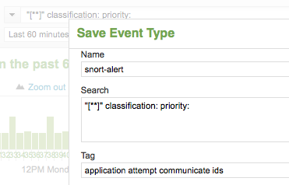
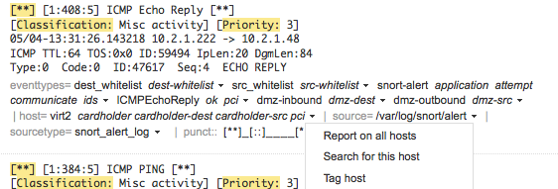
Inside Search-time Knowledge Extraction
Searches saved as event types
Plus tagging of event types, hosts and other fields
... enable normalized reporting, knowledge sharing and granular access control.

Slide 11








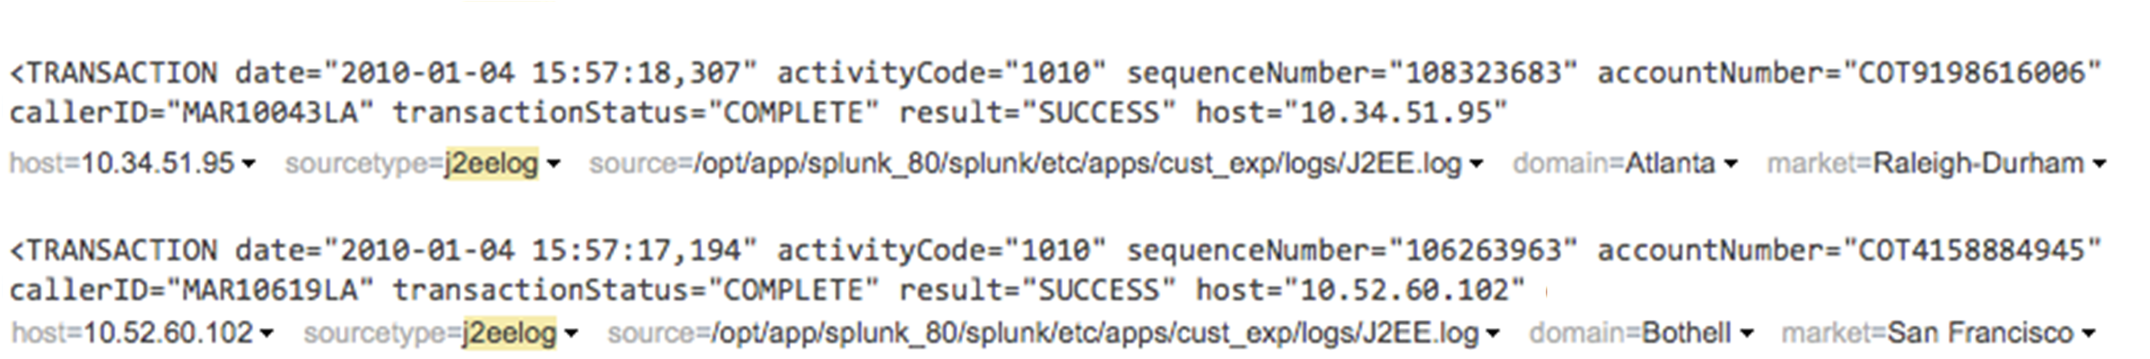
Integrate External Data
Extend search with lookups to external data sources.
LDAP, AD
Watch
Lists
CMDB
CRM/ERP
Geomapping
Pricelist
Correlate IP addresses with locations, accounts with regions
Notes:
Your logs and other IT data are important but often cryptic. You can extend Splunk’s search with lookups to external data sources as well as automate tagging of hosts, users, sources, IP addresses and other fields that appear in your IT data. This enables you to find and summarize IT data according to business impact, logical application, user role and other logical business mappings. In the example shown, Splunk is looking up the server’s IP address to determine which domain the servicing web host is located in, and the customer account number to show which local market the customer is coming from. Using these fields, a search user could create reports pivoted on this information easily.

Slide 12
Inside Splunk’s Search Language
Intermediate results table
Intermediate results table
Final results table
command1 | command2 | command3
Filter
Transform
Enrich
Filter
Transform
Enrich
Filter
Transform
Enrich

Slide 13















Horizontal Scaling
Load balanced search and indexing for massive, linear scale out.
Distributed Search
Forwarder
Auto Load Balancing
Notes:
A single indexers it can index 100-200 gigabytes per day depending the data sources and load from searching. If you have terabytes a day you can linearly scale a single, logical Splunk deployment by adding index servers, using Splunk’s built in forwarder load balancing to distribute the data and using distributed search to provide a single view across all of these servers. Unlike some log management products you get full consolidated reporting and alerting not simply merged query results.
When in doubt, the first rule of scaling is ‘add another commodity indexer.’ Splunk indexers are designed to enable nearly limitless fan-out with linear scalability.

Slide 14
Splunk’s MapReduce-based Architecture
Server 1
Server 2
Server N
Chunk 1
map
Chunk 1
Chunk 1
map
Chunk 2
map
Chunk 2
map
Chunk 2
time
Chunk 3
map
Chunk 3
map
Chunk 3
Chunk 4
map
Chunk 4
map
Chunk 4
map
Search Head
reduce
Answer
Notes:
Splunk utilizes a MapReduce implementation to speed up computation by distributing processing throughout a cluster of many machines. In Splunk this is called “Distributed Search.”
The Splunk MapReduce implementation is part of a complete solution for collecting, storing and processing IT data in real time
Traditional mapred: chunks are random or based on hashes of the raw data…batch processing phase that takes the raw data and hashes the data to establish equivalence classes (server,chunk) push the data into a particular chunk or particular server
In Splunk, the data is partitioned into chunks by time and the map function is applied on each chunk. Then all the results of the map functions are aggregated and filtered at the reduce step to provide the answer.
For example, it’s not trivial to calculate “the average number of errors per host”…with this implementation, the map function can just give you a breakdown of total number of errors per host on each node per time chunk, then the reduce step can aggregate the sums per host and calculate the average number of errors.
Adding more servers gives linear scaling

Slide 15
Unique Characteristics of Splunk MapReduce
Temporal MapReduce
Preview in-progress searches
Streaming indexing system tied to MapReduce enables real-time searches
Simplified Search Language
Notes:
Because we’re hosting splunk for customers, we can really learn how customers use the product
Provide proactive instead of reactive support
Opening up a new market of customers that primarily use services that we don’t fully address today

Slide 16
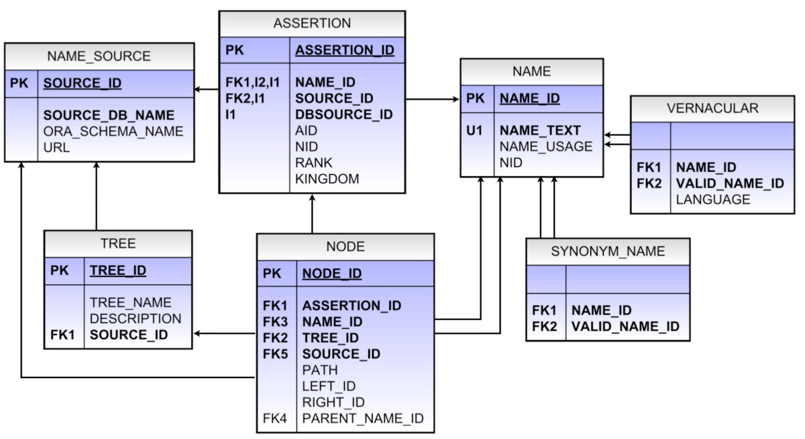
RDBMS/SQL – Early Structure Binding
Structure | Data
Schema – created at design time Queries – understood at design time for maximum performance | Homogeneous – must fit into tables or be converted to fit into tables Must exactly match constraints
SELECT customers.* FROM customers
WHERE customers.customer_id NOT IN(SELECT customer_id FROM orders WHERE year(orders.order_date) = 2004)
Notes:
Many of you are familiar with SQL and writing SQL queries to relational databases. How is Splunk different from using a relational database to query for insights?
Basically, you need to create a good schema for the data at design time (and hopefully not have to change the schema later)
This means you also need to know what types of queries you’re like to run against the data to design a good schema
As for the data, you need to make sure you figure out what the tables should look like and how to convert the data to fit into the tables

Slide 17

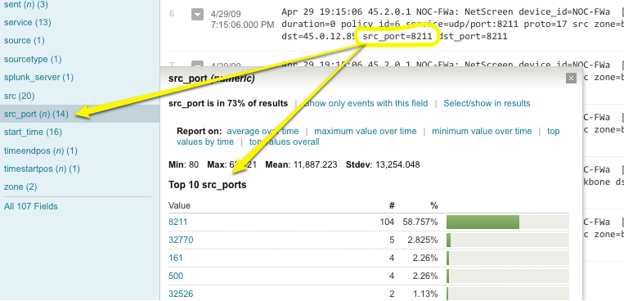
Late Structure Binding
Structure | Data
Schema-less Created at search time Queries/Searches can be ad-hoc | Heterogeneous – can come from any text-based source Constantly changing No conversion required, no constraints
Notes:
With Splunk, there’s no need to specify a schema.
We create structure at search time so the queries and searches can be totally ad-hoc.
The data can come from a variety of text based sources and can continuously evolve without playing with data formats and such

Slide 18

Different Approaches to Data Analytics
SQL-Based Tool
Decide the question(s) you want to ask
Write Semantic
Business Log Lines
Design the Schema
Collect w/ Splunk
Normalize data and write
DB insertion code
Create Searches
Reports, Graphs
Create SQL & Feed into
Analytics Tool
Notes:
How does this impact Data Analytics?
With SQL, you need to figure out what queries you expect and design a good schema for it, then load your data and then write the query, feed it to the analytics tool etc.
With Splunk, you just index your logs, then write searches to generate reports and graphs.
Schema – created at design time
Queries – understood at design time for maximum performance
Homogeneous – must fit into tables or be converted to fit into tables
Must exactly match constraints
Schema-less
Created at search time
Queries/Searches can be ad-hoc
Heterogeneous – can come from any text-based source
Constantly changing
No conversion required, no constraints

Slide 19
Outlier Detection
Example: Find scores more than 3 standard deviations more or less than the average.
search score = ∗
| eventstats avg(score) as avg stdev(score) as stdev
| where (score > avg + 3 ∗ stdev) or (score < avg − 3∗stdev)
Notes:
Event stats

Slide 20
Correlation
Example: Correlate score with income.
Search score = ∗ income = ∗
| stats avg(eval(score ∗ income)) as avg_prod
avg(score) as avg_score
avg(income) as avg_income
| eval cov = avg_prod − avg_score ∗ avg_income
Notes:
Correlation is a scaled version of covariance
Cov/stddev(X)stddev(Y)

Slide 21
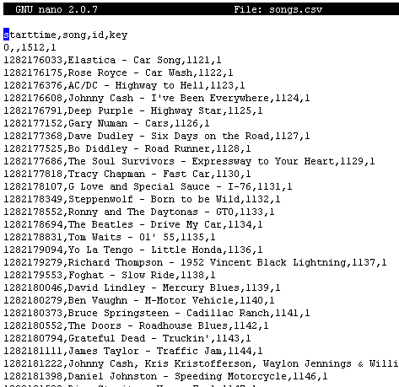
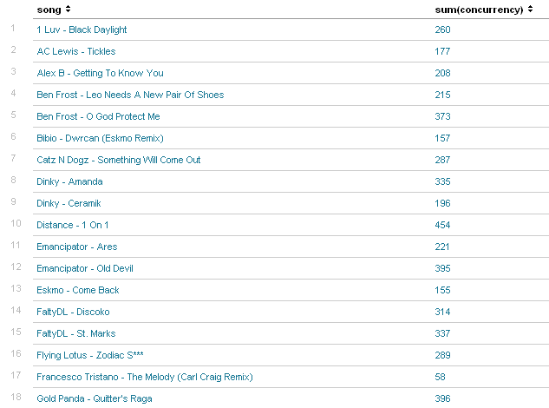
Grouping Transactions
> transaction IPAddress startswith="play" endswith="stop" | concurrency duration=duration | eval key=1 | lookup songs key | stats first(song) as song max(concurrency) as concurrency by id | stats sum(concurrency) by song

Slide 22
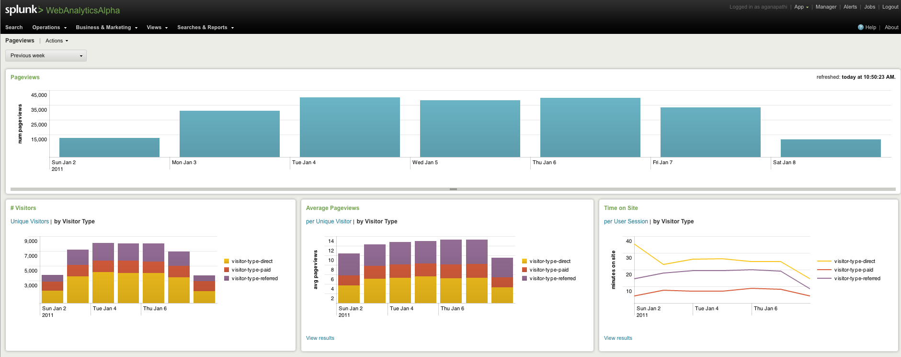
Visualize It In A High-level Dashboard

Slide 23
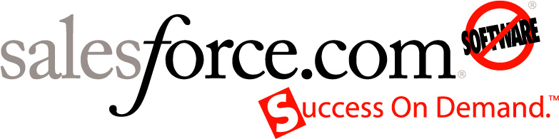
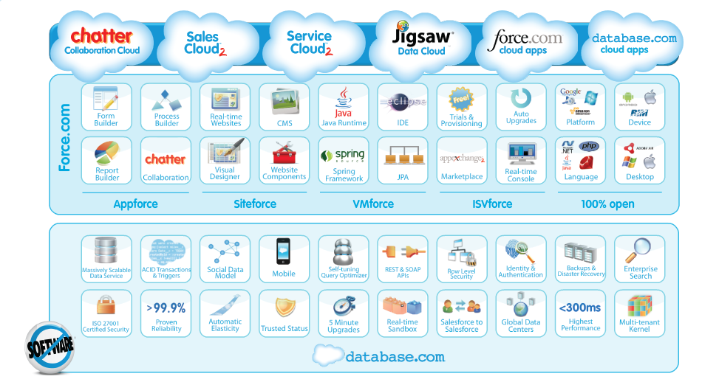
Core services for 87,200 successful customers:
CRM applications for sales and customer service
Enterprise collaboration application
Cloud platform for building apps

Slide 24
Data Mining Challenges
Need for centralized view across datacenters, pods, log types
1/2 TB of raw data per day, 180 TB per year
Critical to reduce MTTR and align R&D and Operations
Need for real time results
Need for instant insights into performance issues
Real-time feedback on user behavior critical to new product/feature launches
Need for low overhead
Users get easy to use, secure access to relevant data
System is easy to maintain, scales easily and adapts to new and changing forms of data
Critical for keeping Ops, R&D and Security teams happy
Historical trending versus real-time views
400M transactions per day, 140B transactions per year

Slide 25
The Answer: Splunk
Need for centralized view across datacenters, pods, log types
Need for real time results
Need for low overhead
Within 6 months there were 300 users and 72,000 concurrent searches running on the Splunk platform
Bonus!
“The fact that we had a data treasure chest was not obvious till Splunk came in to the picture.”
Watched user activity in real time as to understand success of new features as they launch
“We have taken application performance troubleshooting for 72,000 customers to the next level.”
“Splunk has enabled us to make data-driven decisions.”
Performance teams live on Splunk every day, every hour

Slide 26
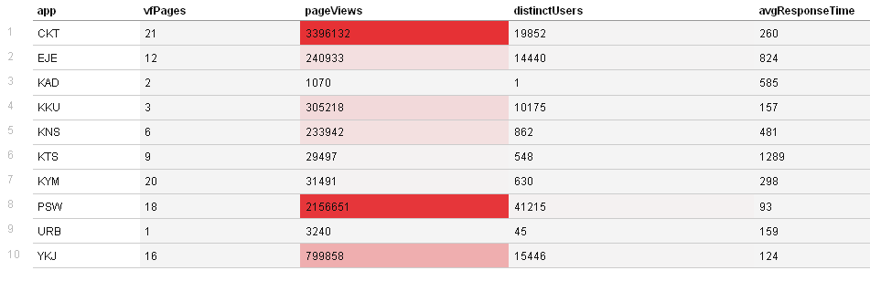
Monitoring Customer Usage
Notes:
Salesforce architecture

Slide 27
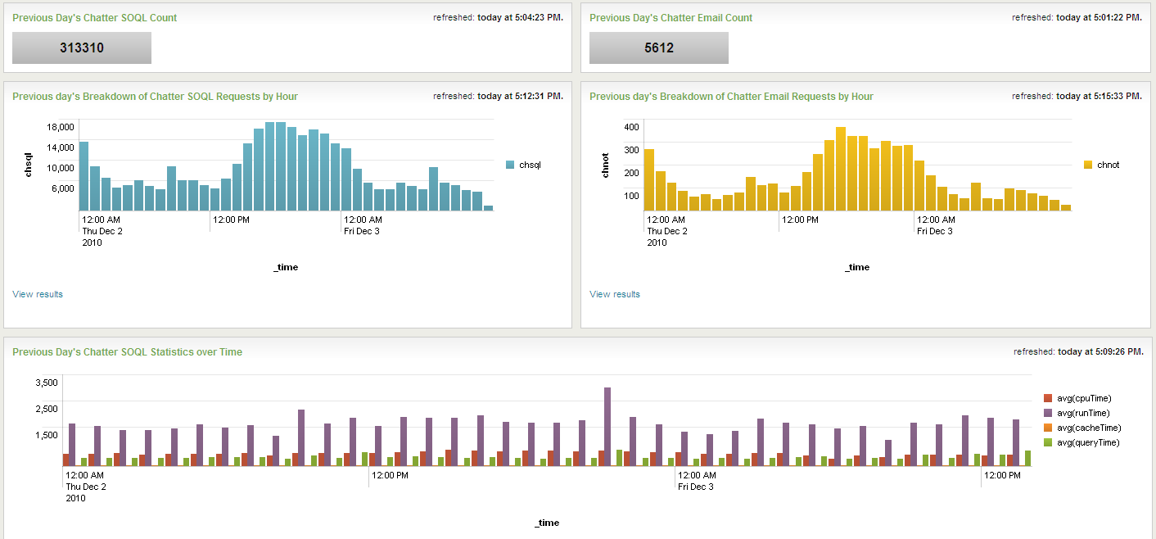
Launching New Features
Product Management team mapping Splunk for web analytics to get full picture of user activities
Helps to refine features, drive enhanced user experience
Dashboards show trending and baseline vs. changes when new features launch

Slide 28

Other Benefits with Splunk
Capacity planning, forecasting and longer term strategy planning
Developers using data from Splunk to inform product direction and decisions
Splunk data is informing the reports we send to execs—it’s our Operational Intelligence platform

Slide 29




















2,300+ Licensed Customers in 74 Countries
Aerospace & Defense
Energy
Computer Hardware
High Technology/Software
Education
Financial Services
Government
Healthcare
Insurance
Manufacturing
Media & Entertainment
Network Equipment
Online Services
Biotech/Pharmaceuticals
Professional Services
Retail
Technology Service Providers
Telecommunications
Transportation
Travel & Leisure
Notes:
Since June 2006, more than 1,600 users have purchased the enterprise license (Feb 2010)
These enterprise customers now use Splunk across a balanced and wide range of industries from telecommunications, financial services, government and large consumer facing internet services. Last year, 2009, over 650 new customers started using Splunk.
Like the customer examples we just saw, these customers have transformed the management, security and compliance of their IT infrastructures with IT Search.

Slide 30
Thank You
February 3, 2011

Slide 31
Challenges Give Way To Insight
Machine generated data – while challenging to manage can yield insight to drive your business and uncover new opportunities
Splunk can help you make sense of very large quantities of machine data

Slide 32
Backup

Slide 33


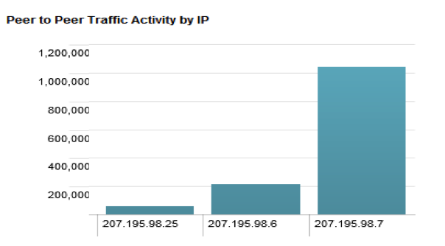
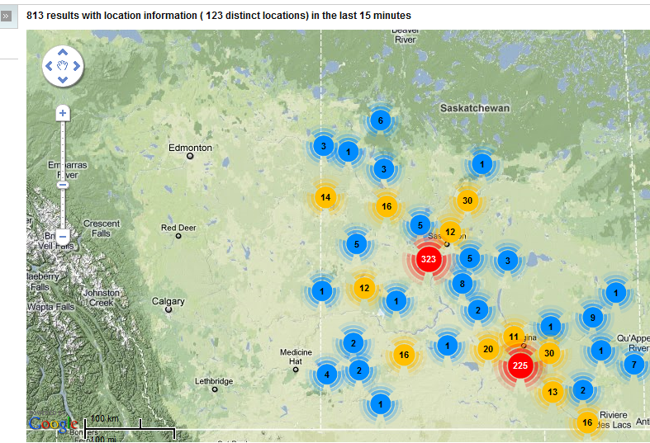
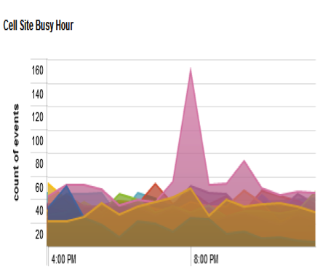
Pinpointing heaviest ‘users’ and heaviest ‘abusers’
Identifying customer trends
Correlating trends

Slide 34

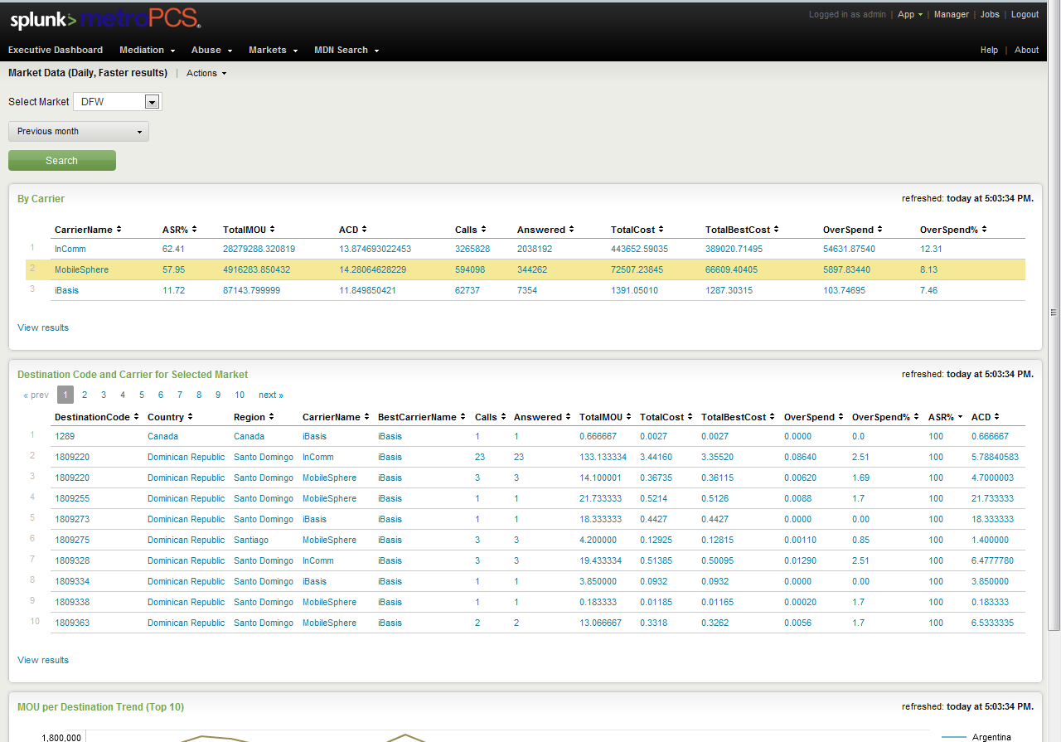
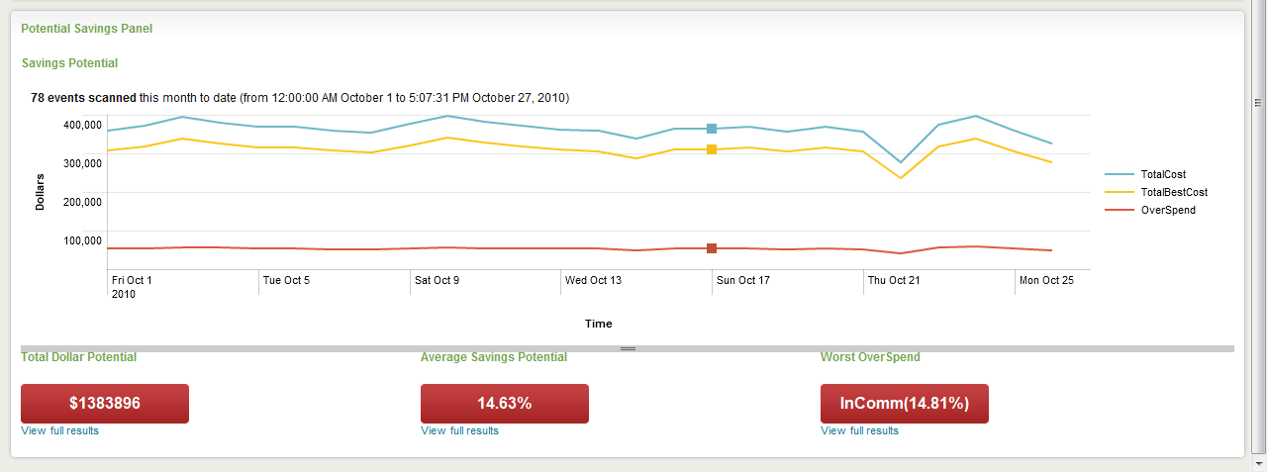
Revenue optimization
Using RDB lookup to calculate cost per call
CDR visibility
Ingest any CDR format and provide ARPU visibility
Detecting abuse
Splunk dashboards highlights ‘terms of service’ abusers

Slide 35
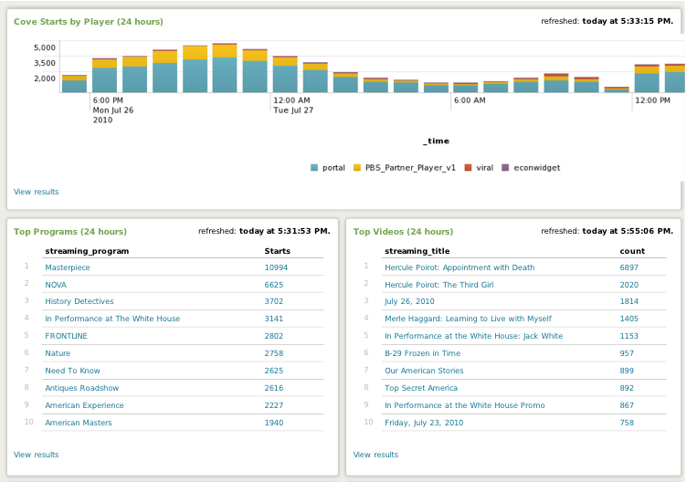
National Media Outlet
Visibility and reports about web-based digital assets
  Programming popularity
  Tracked abandonment rates & errors
  Added views by player

